Slide 1

Research Design + Proposal Writing (CA1) - Research Question - Hypothesis - Preliminary Design
Ciaran Finnegan
TU006 Yr 2 Data Science
Std No: d21124026

Slide 2
Domain, scope, assumptions, limitations and delimitations of research - ACM 2012
DOMAIN: (Cite the relevant articles that you have read (7+) across these 5 branches, according to the APA7 style).
A: nnnn → nnnn → nnnn → nnnn
B: nnnn → nnnn → nnnn → nnnn
C: nnnn → nnnn → nnnn → nnnn
D: nnnn → nnnn → nnnn → nnnn
E: nnnn → nnnn → nnnn → nnnn
SCOPE: One line…ipso lorem…ipso lorem..
ASSUMPTIONS: One line…ipso lorem…ipso lorem..
LIMITATIONS : One line…ipso lorem…ipso lorem..
DELIMITATIONS : One line…ipso lorem…ipso lorem..

Slide 3

Credit Card Fraud Detection
Higher Diploma in Science in Data Analytics : Capstone Project
Student : Ciaran Finnegan No: 10524150
March 2019 Intake : Fri / Sat
Presentation
A predictive analysis project to implement an application for credit card fraud detection using Machine Learning techniques and internet hosted deployment technologies…

Slide 4
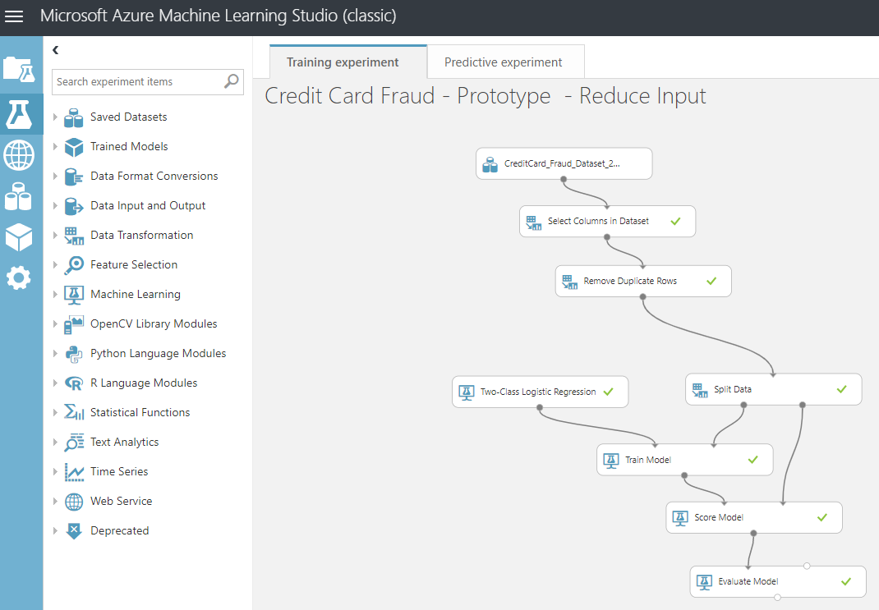


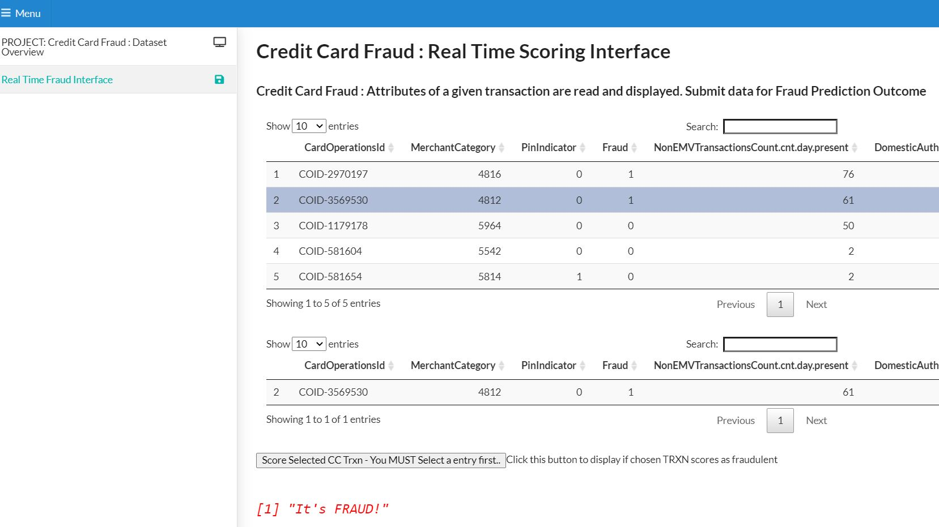
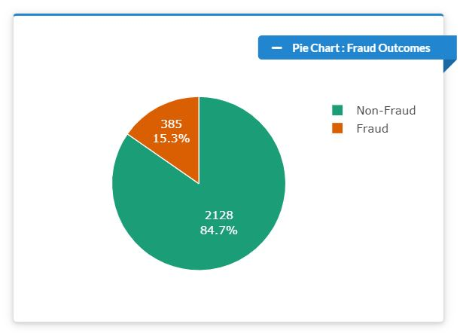
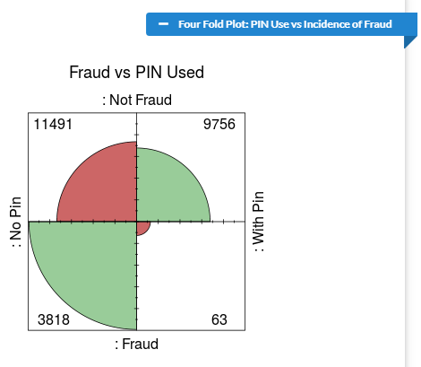
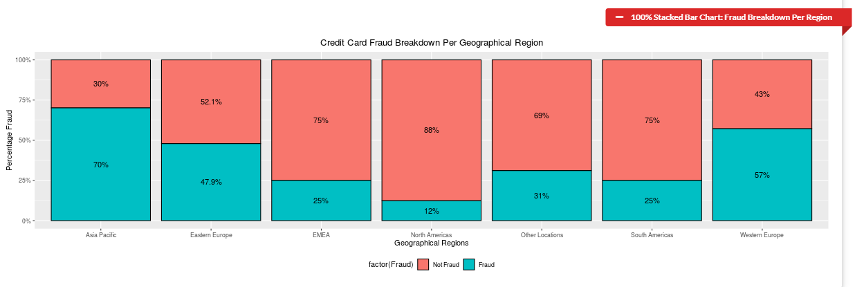
Project Objectives
Build a predictive credit card fraud model in Microsoft Azure Machine Learning (studio)

Slide 5
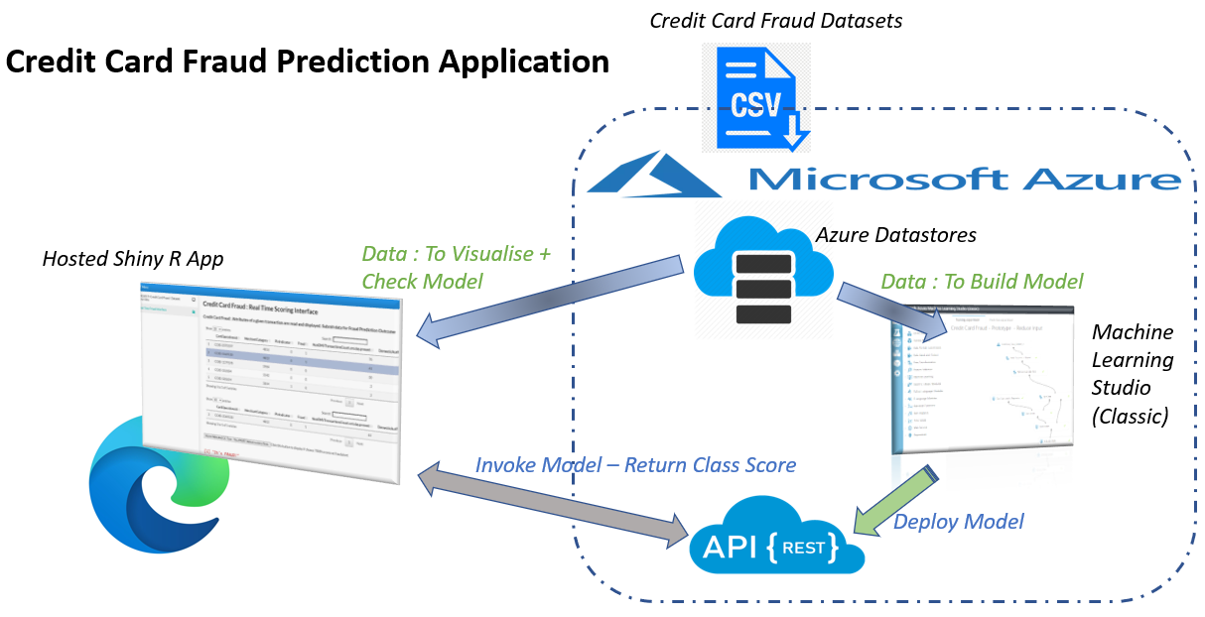
Project Architecture

Slide 6
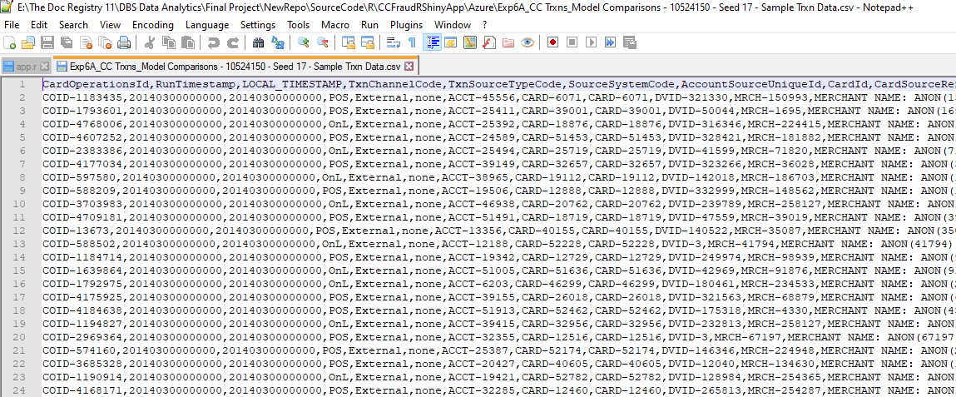
Credit Card Dataset
Company data for obsolete product line (2014).
25K rows / 380 columns
Each row represents a unique credit card transaction with a ‘label’ Feature confirming if the record was a case of fraud or legitimate.
Contains a numbers of data elements related to interfaces with legacy systems and therefore redundant for the purposes of predictive fraud modelling.

Slide 7
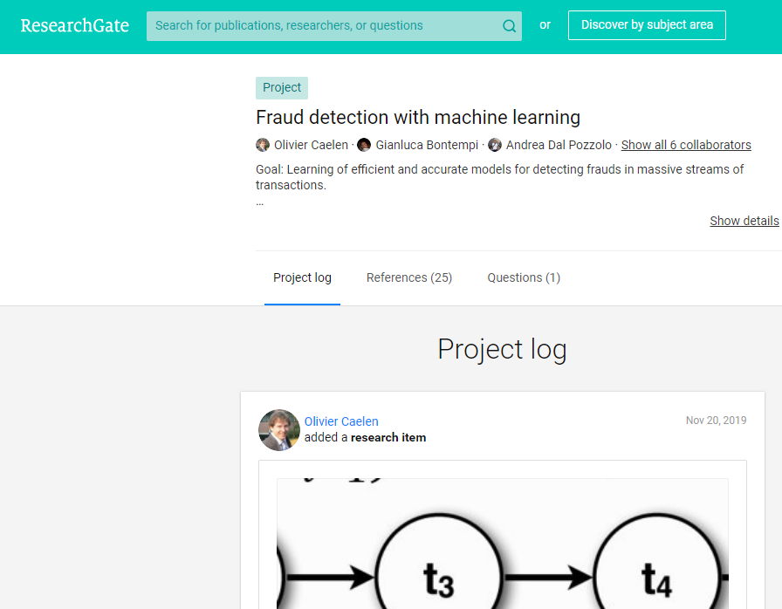
Credit Card Fraud : Research (1)
ResearchGate.Net – Active credit card fraud detection research programme using Machine Learning techniques.
Machine Learning Group – University of Brussels. Produced the most widely available dataset on credit card fraud detection in sites such as Kaggle. European data from 2013. Heavily anonymised.

Slide 8
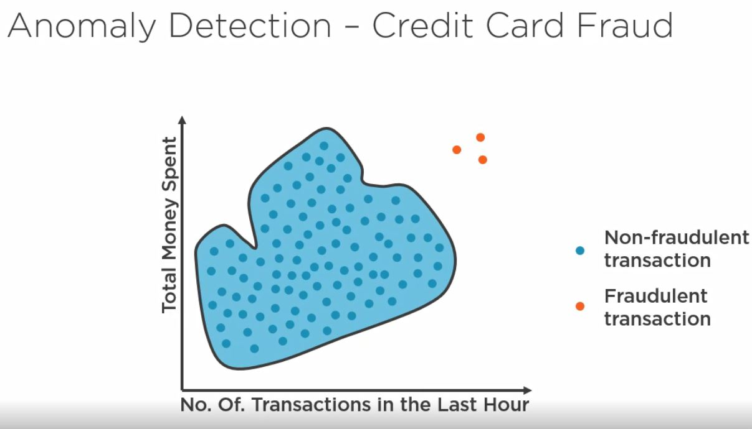
Credit Card Fraud : Research (2)
Consideration I took from research material in the use of ML for credit card fraud detection…
My dataset has a much greater proportion of fraudulent records than other datasets. Anomaly detection approaches would not be necessary.
Feature Engineering would be essential. Credit card datasets tend to contain many features with little relevance to indicating ‘Fraud’. My dataset was no different.
My dataset was considerably smaller than other research datasets. An unavoidable limitation.
My dataset is primarily US data (from 2014). It has not undergone the type of PCA manipulation seen in the ULB dataset. Many of the features are easily understandable from a business domain perspective.

Slide 9



Project ‘Roles’
The primary requirement for the project was to capture and end-to-end solution for credit card detection for the following roles..
The Fraud ‘Investigator’ : using the Shiny R dashboard to check ‘new’ transactions for Fraud.
The Data Engineer : setting up an Azure ML Studio (classic) platform to build, train and deploy the predictive fraud model.
The Data Scientist : use the Azure ML Studio development environment to create an effective predictive fraud model.

Slide 10
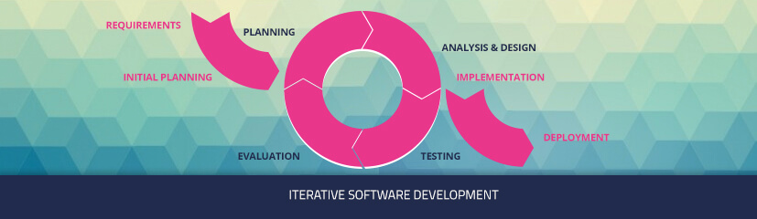
Project Management Approach
Be ‘AGILE’..
Work was broken into a sequence of ‘User Stories’. The focus was on ‘working software’ to ‘demo’ at the end of each User Story.

Slide 11
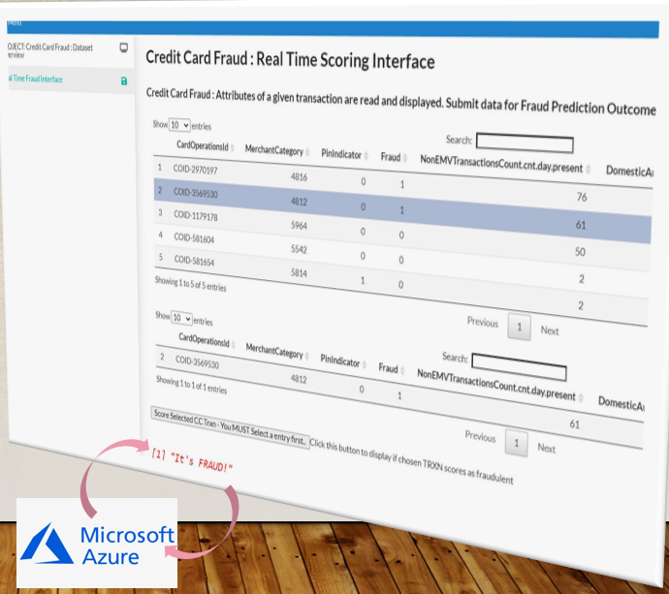
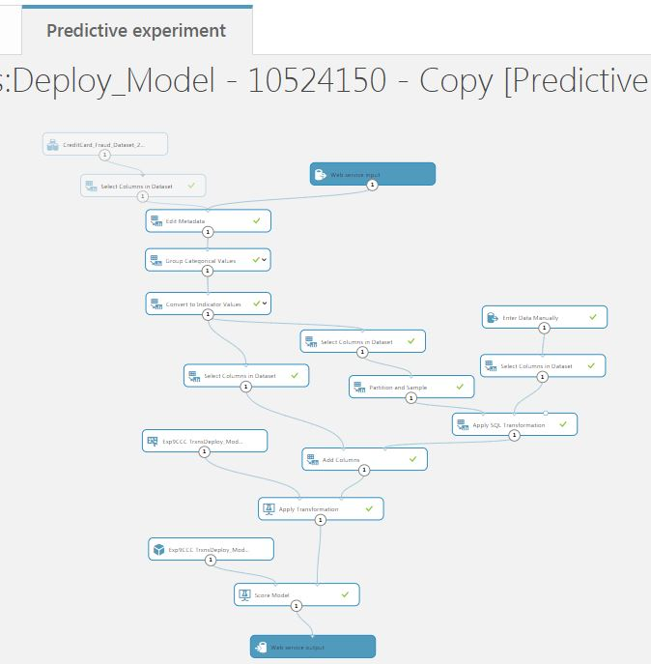
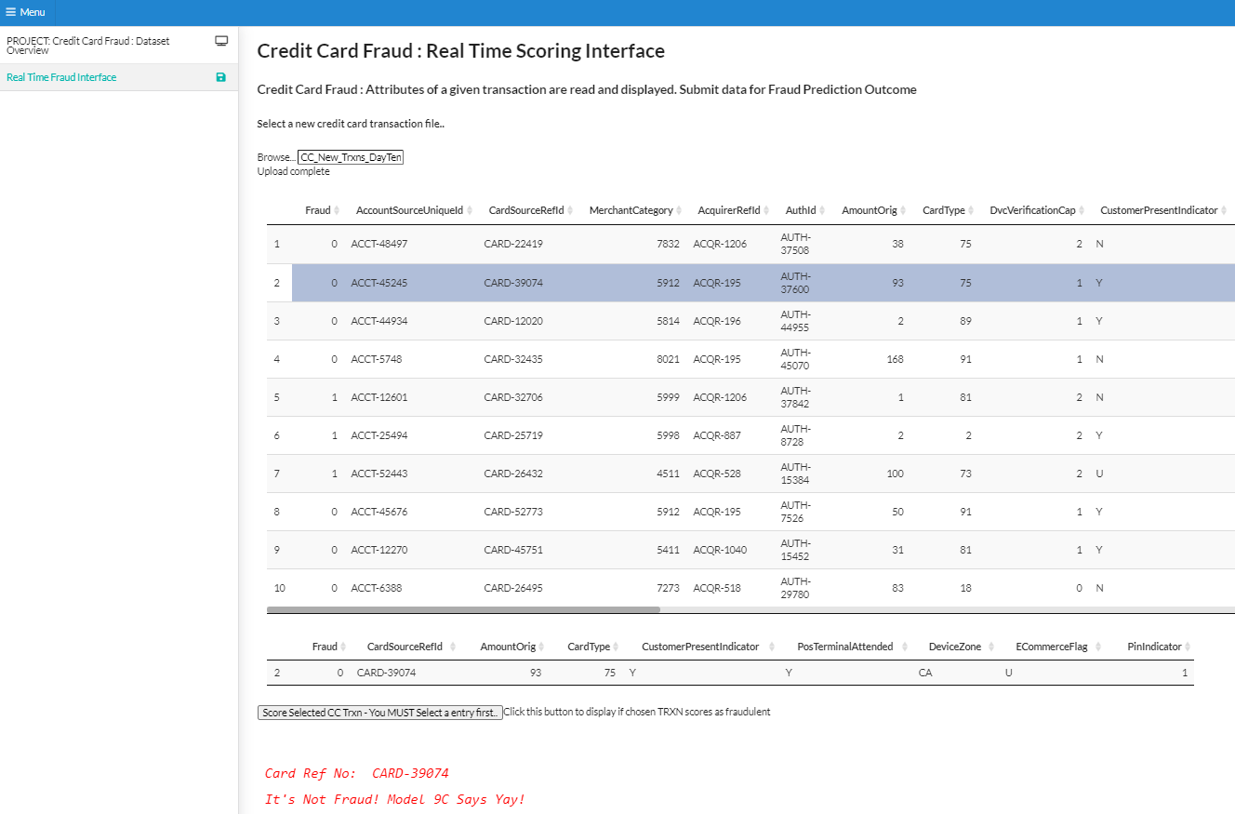
Project Approach
The first set of User Stories built incrementally to the Prototype at the Interim Report Stage..
Later User Stories incrementally a more reliable predictive model and enhanced Shiny dashboard..

Slide 12
DEMO..

Slide 13
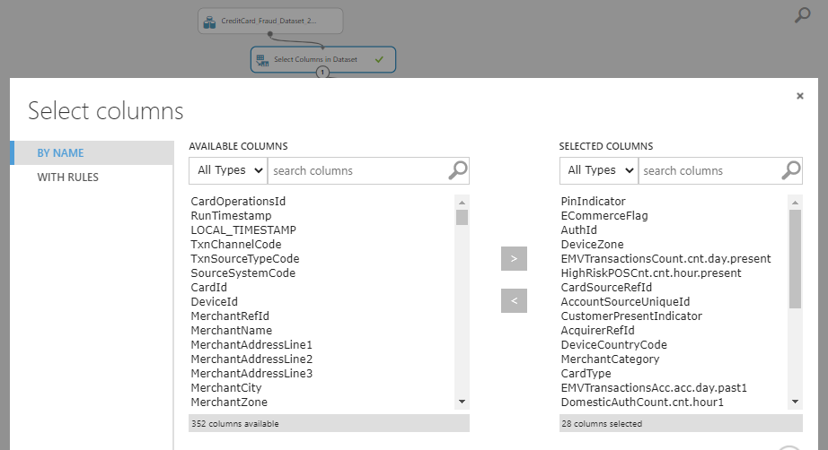
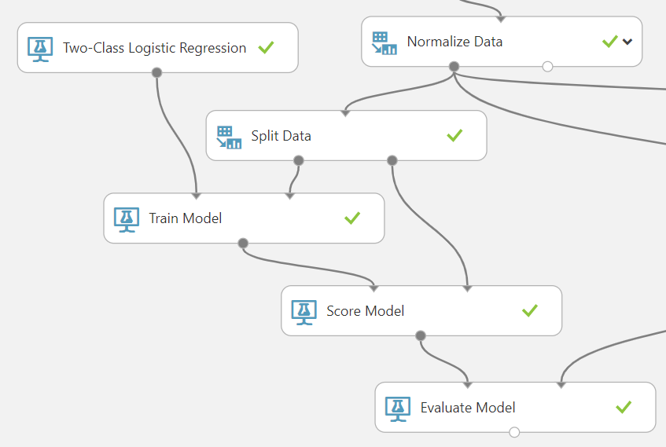
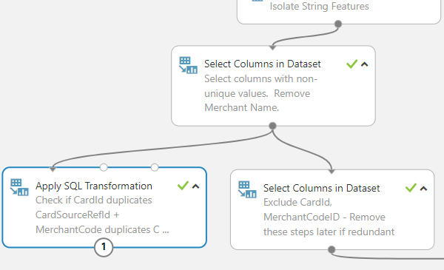
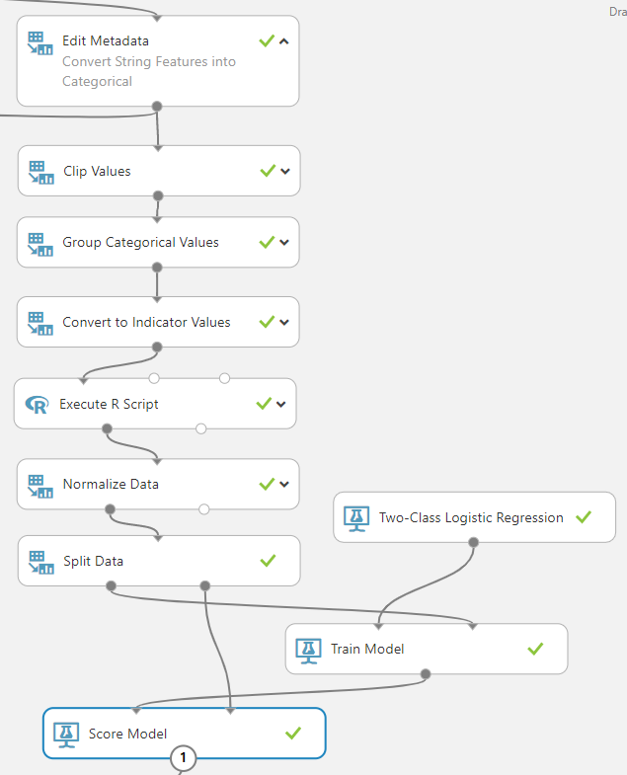
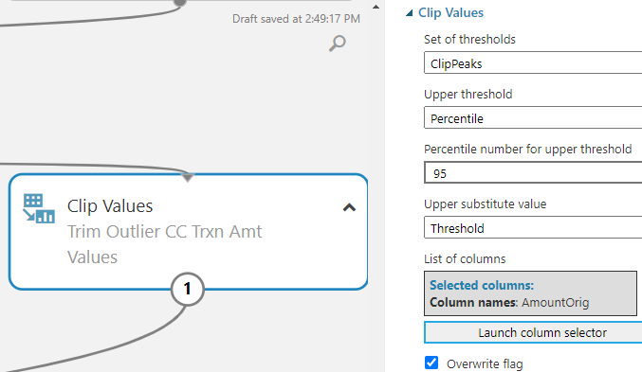
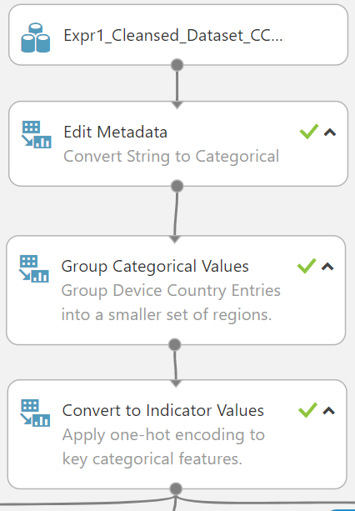
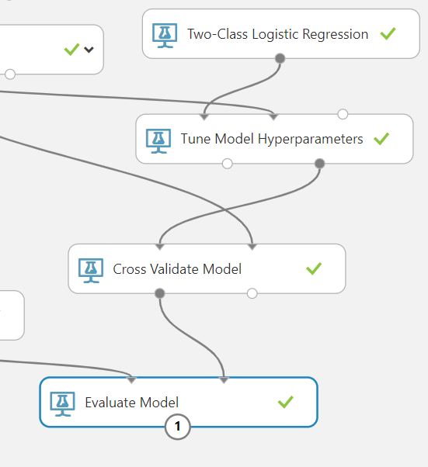
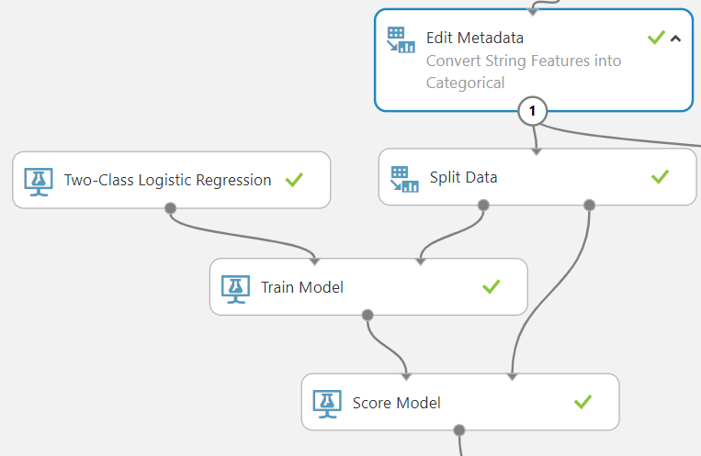
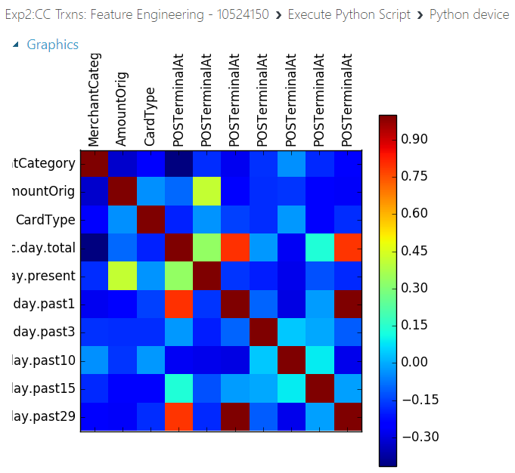
Microsoft Azure ML Studio (classic)
Walkthrough of experiments used to build the predictive credit card model deployed in this project..

Slide 14
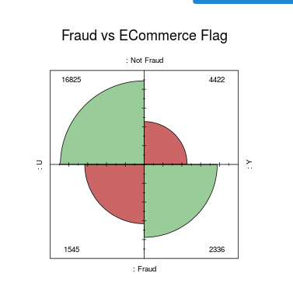
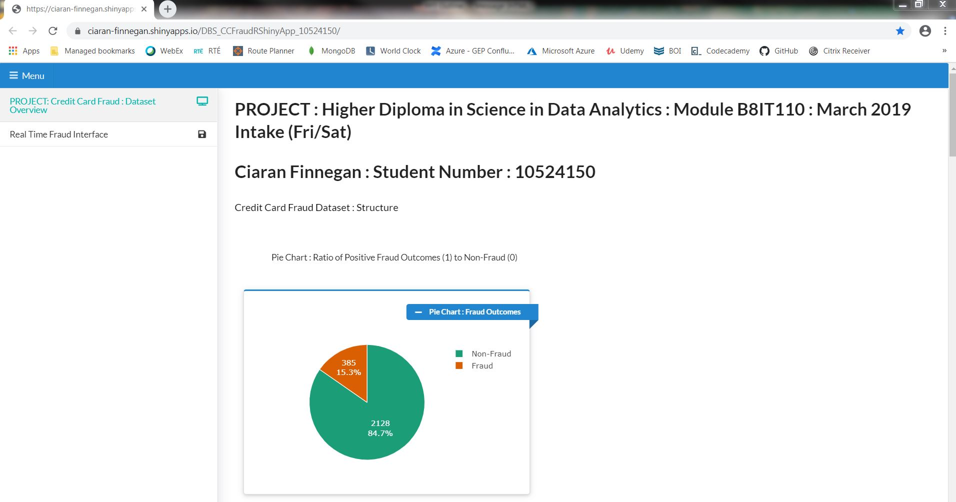
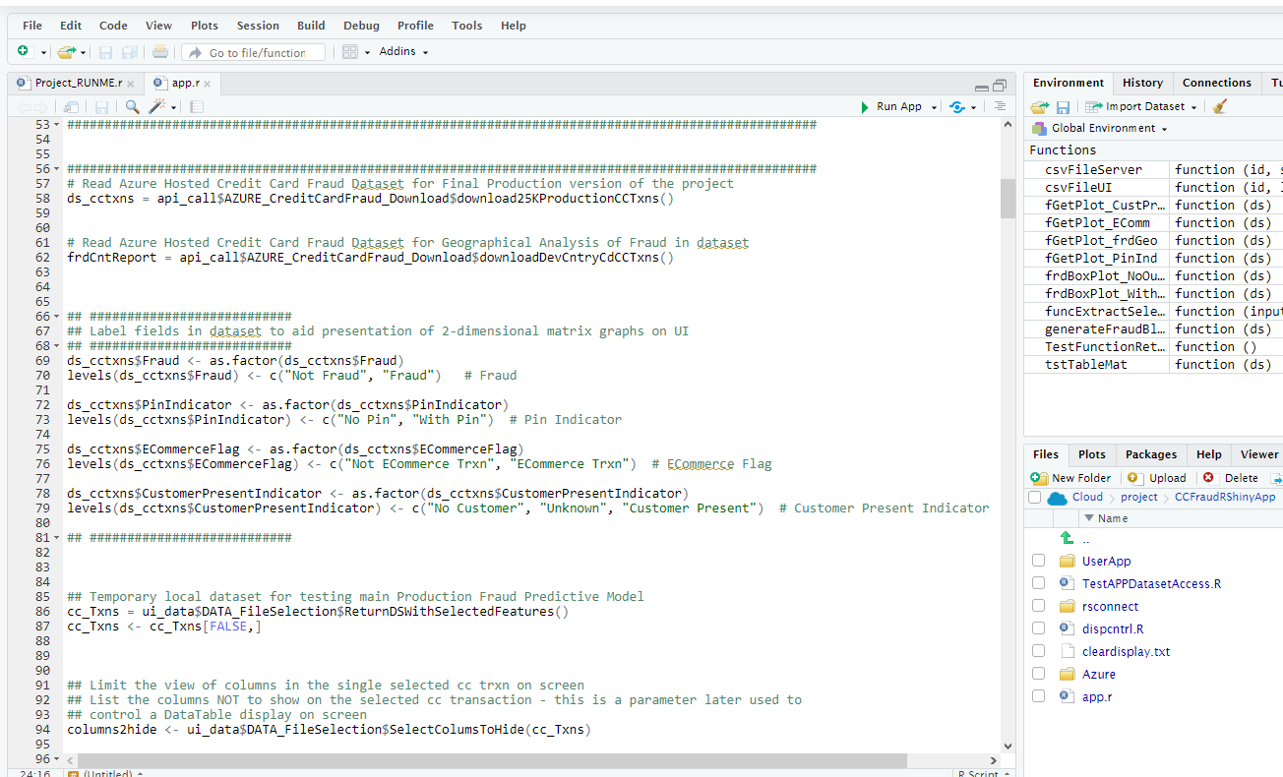
Shiny R Dashboard
Walkthrough of RStudio Cloud code base for Shiny R dashboard..

Slide 15
Future Considerations
Iterative approach to project management worked very well.
Microsoft Azure ML ‘Services’ is a more up to date ML platform but has reliability and cost issues (The ‘classic’ version is more straightforward to use and cheaper).
I had access to a larger dataset but the format was in DSV and Azure ML Studio was not compatible. Future development may warrant a change of platform to AWS or Google Collabnet.

Slide 16

Questions?

